Slide 1


Slide 2

DESIGNED BY MARINERS, OUR PROJECT AIMS TO SUPPORT OWNER AND SHIP CREW TO IMPROVE SAFETY, PLANNING AND EXECUTION IN LOADING, CARRYING AND DELIVERING BULK CARGOES.

Slide 3
PROBLEM
SOLUTION
Ship – shore communication is done via the traditional way of emails for all tasks.
Bulk Carrier operations are presently based on individual analysis of effort, which increase error.
Single person failure can cause vessel holds to fails and serious loss for owners / head charterer.
Usage of dashboard system and analytics.
Reduced time & concise communication.
Removal of reporting bias, prediction of time and resource, job scheduling and job guidance.

Slide 4

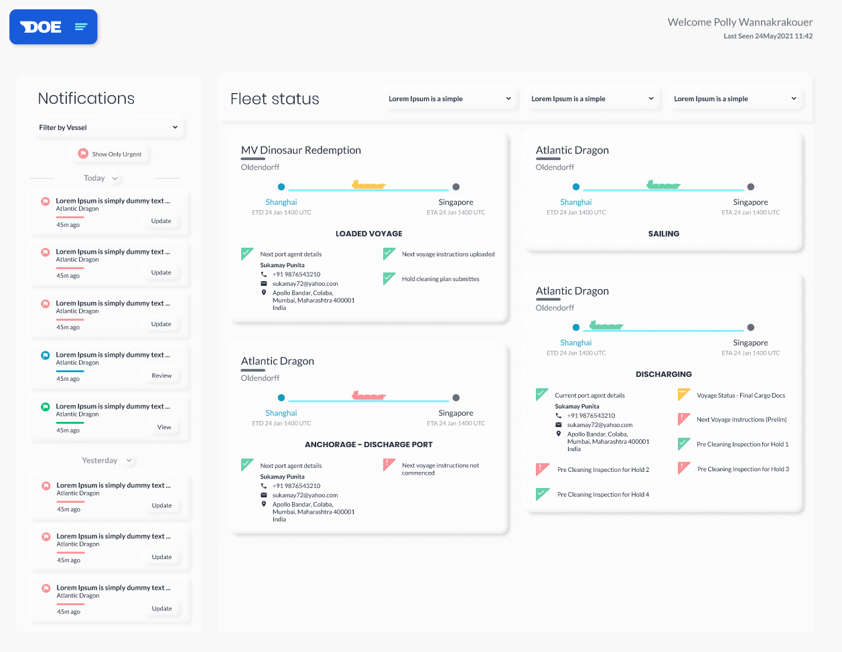
What is iBulk?
iBulk addresses cargo loading, cargo carriage and discharging on bulk carriers.
It is a single platform for data entry and automatic task and equipment prediction.
It streamlines information exchange and reduce workload both ship & shore.

Slide 5
BENEFITS
Reduced email
communication / reports
Auto scheduling of
tasks and generates
reminders
Uniformity of data
across ship and shore
History of vessel and
fleet in a single platform
Multiple interface
and ease of access
Care and guidance
from office and industry

Slide 6


MULTI GENERATION PLAN
PHASE 1
VOYAGE INSTRUCTION
HOLD PREPARATIONS
PHASE 2
CARGO MONITORING
CARGO GUIDANCE
PHASE 3
CLAIMS HANDLING
BUSINESS INTELLIGENCE

Slide 7
FIRST LOOK - Modules
Voyage
Cargo
Hold
Guidance
Inventory

Slide 8
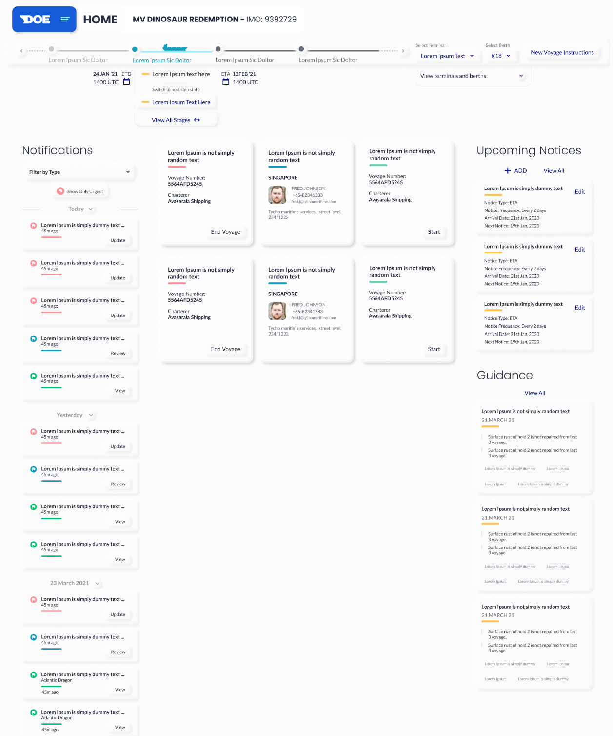
VOY INSTRUCTION MODULE
HOME PAGE - VESSEL

Slide 9
VOY INSTRUCTION MODULE
HOME PAGE - SHORE

Slide 10

HOLD PREPARATION
Auto estimation of Hold Cleaning time
System aided Hold Cleaning planning module
Daily work done updates and auto generation of reports.
Auto notification and alert of defects / damage history of holds.

Slide 11
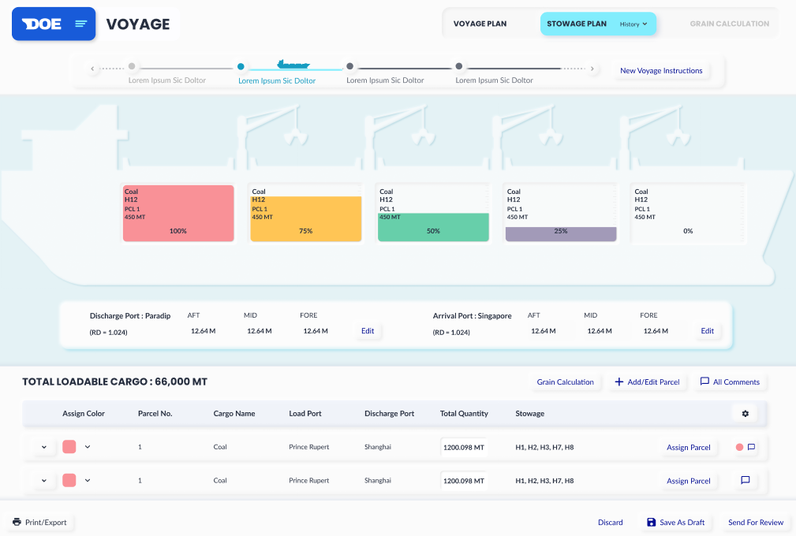
CARGO HOLD MODULE
STOWAGE PLAN

Slide 12
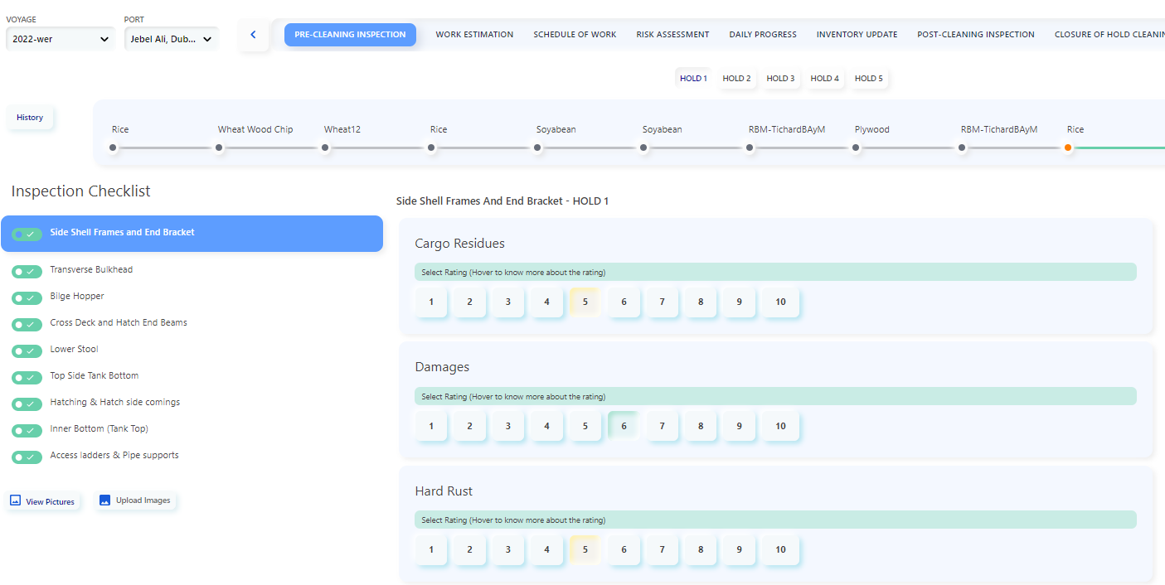
CARGO HOLD MODULE
PRE – CLEANING INSPECTION CHECKLIST

Slide 13
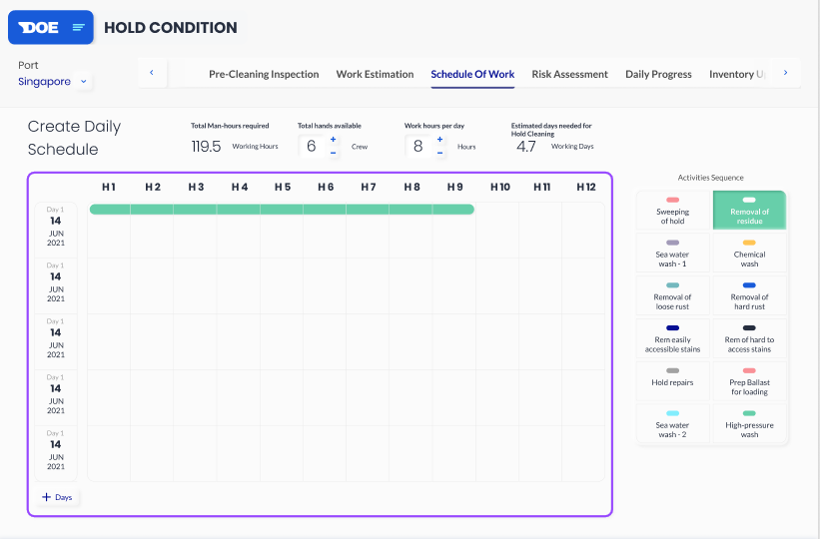
CARGO HOLD MODULE
SCHEDULING OF WORK

Slide 14


INVENTORY MODULE
Ship and cargo Specific Inventory requirements.
Ensures minimum quantity for hold cleaning is always maintained.
Cart based requisition process system.
Planned inspection of Equipment.
Auto notification, reminders and alerts under various heads.
History of supplies under various filters.

Slide 15
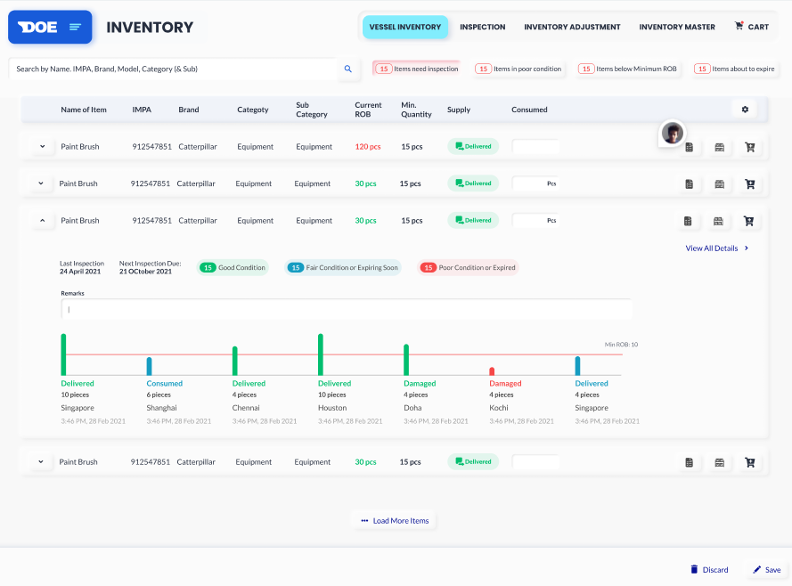
INVENTORY MODULE

Slide 16


GUIDANCE MODULE
Comprehensive database of Industry wide documents.
I-Bulk specific guidance related to bulk carrier operations.
Access to company manuals and guidelines related to cargo care and operations.
User option to request for various available guidelines from the system.

Slide 17
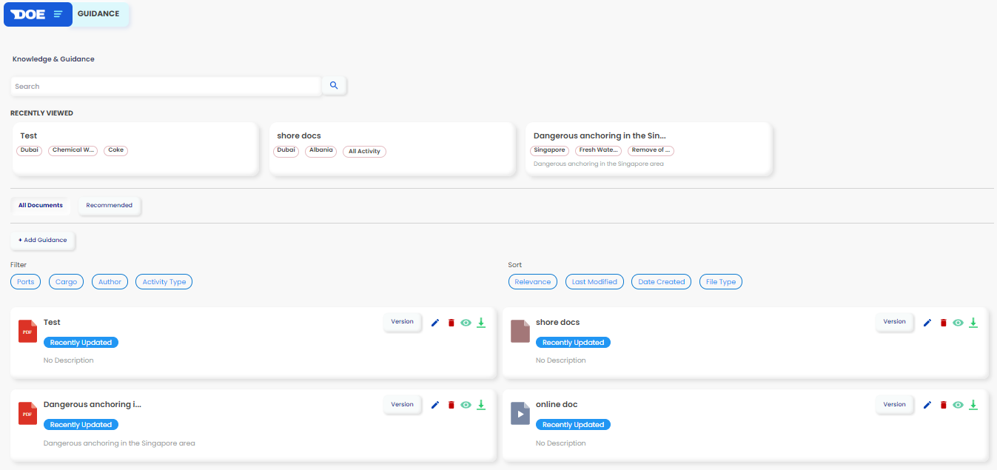
GUIDANCE MODULE

Slide 18
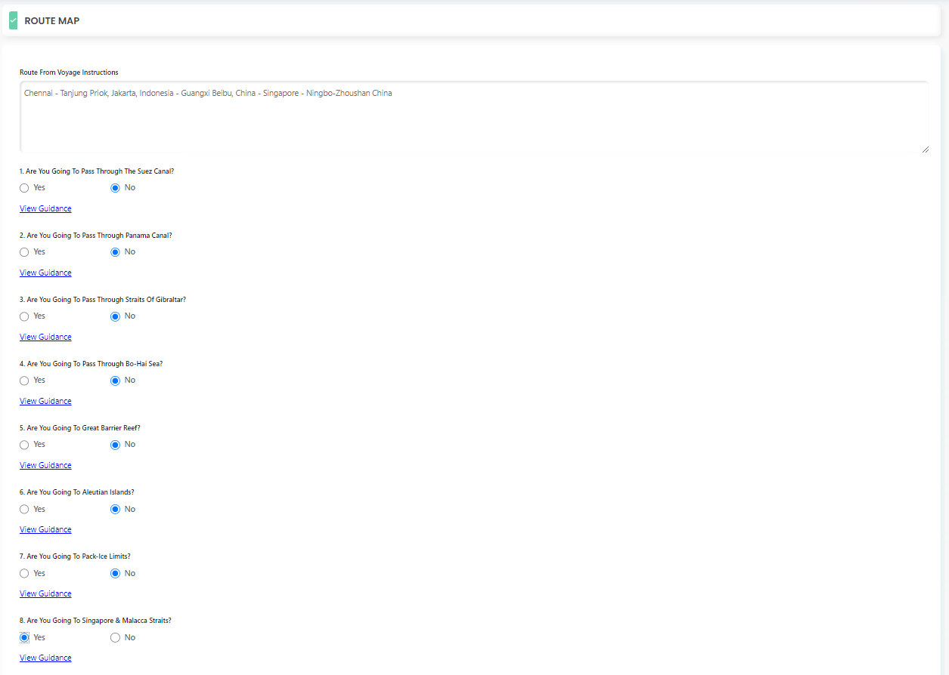
GUIDANCE MODULE

Slide 19
OWNERS SCREEN - DRAFT

Slide 20
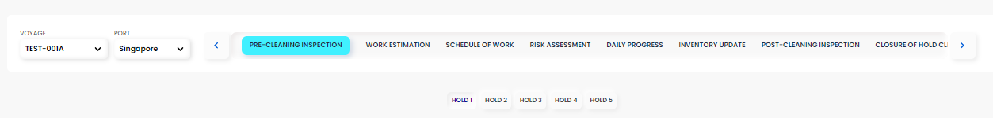
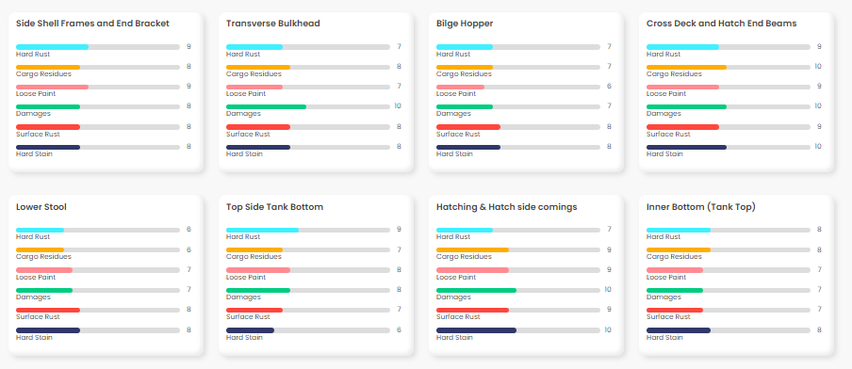

Slide 21
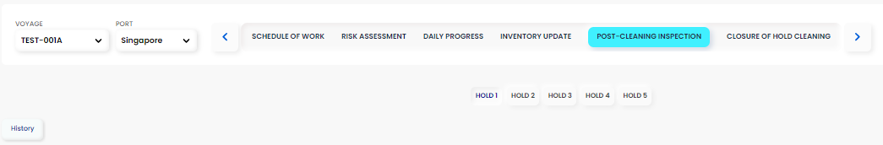
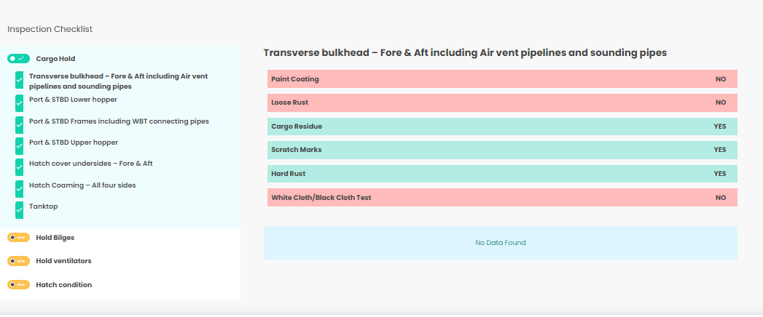

Slide 22
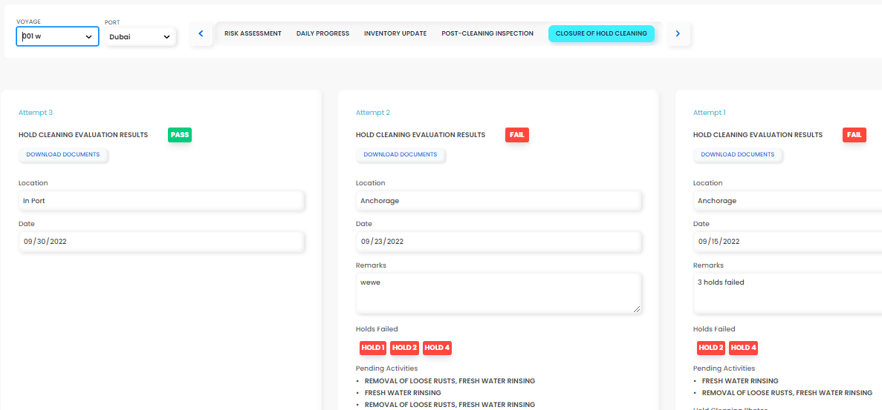

Slide 23
THANK YOU!!!

